Slide 1
Baysean Inference
https://www.youtube.com/watch?v=-e8wOcaascM
P(θ|data) = [P(data|θ) x P(θ)] / P(data)
Thomas Bayes 1701-1761

Slide 2
Z: 確率変数 (random variables)
P(Z) : 確率質量関数 (probability mass function)
P(Z) = 1
^{i i}

Slide 3
Z: 確率変数 (random variables)
P(Z) : 確率質量関数 (probability mass function)
コイン投げ (Coin throw) Z = おもて: 1 or うら：0
P(1) = 0.5, P(0) = 0.5
1.0
P
0.5
P(Z=1) + P(Z=0) = 1
0
Z= 1 Z = 0

Slide 4
サイコロ投げ （Dice throw) Z = 1, 2, 3, 4, 5, 6
P(1) = 1/6, P(2) = 1/6, P(1) = 1/6, P(2) = 1/6, P(1) = 1/6, P(2) = 1/6,
1.0
P
1/6
0
Z = 1 Z = 2
Z = 3 Z = 4 Z= 5 Z = 6
P(Z=1) + P(Z=2) + P(Z=3) + P(Z=4) + P(Z=5) + P(Z=6) = Σ P(Z = i ) = 1
^{I}

Slide 5
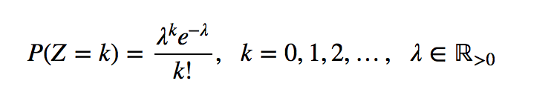
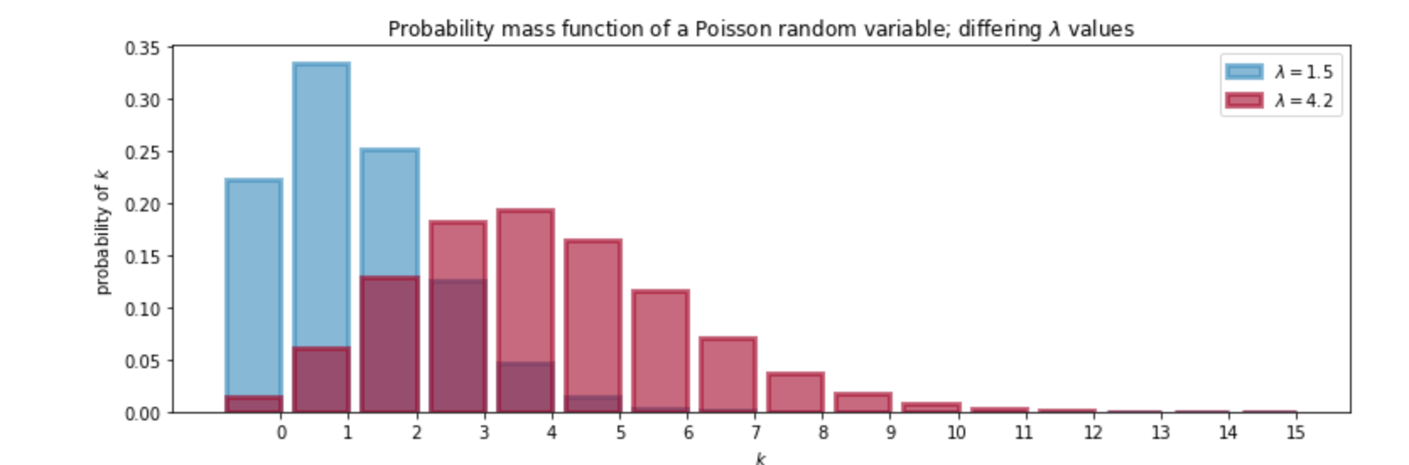
ポアソン分布 (Poisson Distribution)
10Kgのパン生地に400粒のレーズンをいれてこねた後、
0.1Kgずつのパンに分けて焼いた時、パン一個あたりの
レーズンの数の分布は？ λ = 4

Slide 6
競馬の例 （Horse Race) : 馬A と 馬B の勝敗の割合
A
 | 0 負 (lose) | １ 勝 (win)
0 負 (lose) | 30/100 | 10/100
1 勝 (win) | 10/100 | 50/100
B
₁ ₁
Σ P(Z_{A} = i, Z_{B} = j) = 30/100 + 10/100 + 10/100 + 50/100 = 1
^{i=0 j=0}
Lambert, B. A Student’s Guide to Bayesian Statistics, 2018より引用

Slide 7
競馬の例 （Horse Race) ：周辺分布 (Marginal Distribution)
A
 | 0 負 (lose) | １ 勝 (win)
0 負 (lose) | 30/100 | 10/100
1 勝 (win) | 10/100 | 50/100
P(Z_{B})
40/100
60/100
B
P(Z_{A}) | 40/100 | 60/100
周辺確率
P(Z_{A}=0) = P(Z_{A}=0, Z_{B}=0) + P(Z_{A}=0, Z_{B}=0) = 30/100+10/100 = 40/100

Slide 8
条件付き確率（Conditional Probability)
P(A|B）＝P(A,B)/P(B)
条件付確率 = 同時確率/周辺確率

Slide 9
Aが勝った場合に、Bも勝つ確率
P(Z_{B}=1|Z_{A}=1) = P(Z_{A}=1, Z_{B}=1) / P(Z_{A}=1)
= P(Z_{A}=1, Z_{B}=1) / P(Z_{A}=1, Z_{B}=0) + P(Z_{A}=1, Z_{B}=1)
= (50/100) / [(10/100) + (50/100)] = 5/6
A
 | 0 負 (lose) | １ 勝 (win)
0 負 (lose) | 30/100 | 10/100
1 勝 (win) | 10/100 | 50/100
B
ー＞
Bが勝った場合に
Aが勝つ確率は？

Slide 10
Baysean Inference
https://www.youtube.com/watch?v=-e8wOcaascM
P(θ|data) = [P(data|θ) x P(θ)] / P(data)
Thomas Bayes 1701-1761

Slide 11
ベイズの定理 （Bayes‘s rule)
P(X|Y) = [P(Y|X) x P(X)] / P(Y)
1/ P(X|Y) = P(X,Y)/P(Y)
2/ P(Y|X) = P(X,Y)/P(X)
3/ P(X|Y) x P(Y) = P(X,Y) = P(Y|X) x P(X)
→ P(X|Y) = [P(Y|X) x P(X)] / P(Y)

Slide 12
条件付き確率（Conditional Probability)
P(X|Y）＝P(X,Y)/P(Y)
条件付確率 = 同時確率/周辺確率
Conditional simultaneous (joint) probalibity
Probability / marginal probability

Slide 13
Venn diagram
P(X,Y)
P(Y|X)
P(X|Y)
P(X)
P(Y)

Slide 14
P(X|Y) x P(Y) = P(X,Y) = P(Y|X) x P(X)
→ P(X|Y) = [P(Y|X) x P(X)] / P(Y)

Slide 15
Use of Bayes theorem (modified from Lambert, 2018）
Example of Colon Cancer
Out of all men aged 40, 1% have colon cancer
Screen of colon cancer: 80% of men with colon cancer show positive
10% of men without colon cancer show screen positive
Question: What is the percentage of colon cancer if screen result is positive?
P(cancer) = 0.01
P(Sc+|cancer) = 0.8
P(Sc+|no cancer ) = 0.1 Question: P(cancer|Sc+)
P(cancer|Sc+) x P(Sc+) = P(cancer, Sc+) = P(Sc+|cancer) x P(cancer)
P(cancer|Sc+) = [P(Sc|cancer) x P(cancer) ] / P(Sc+)
P(Sc+) = P(Sc+, cancer) + P(Sc+, no cancer)
= P(Sc+|cancer) x P(cancer) + P(Sc+|no cancer) x P(no cancer)
= (0.8 x 0.01) /0.11 = 0.08
= 0.8 x 0.01 + 0.1 x 0.99 = 0.11

Slide 16
Baysean Inference
https://www.youtube.com/watch?v=-e8wOcaascM
P(θ|data) = [P(data|θ) x P(θ)] / P(data)
Thomas Bayes 1701-1761
Posterior = Likelihood x Prior / P(data)

Slide 17

Likelihood (尤度)
Coin throw (コイン投げ）
P(H) = θ = 0.5
Throw coin twice (２回コイン投げをする時の結果）
Head (表）
Tail (裏）
1st throw １回目 2nd throw 2回目
P(H, H) = θ ² = 0.5 x 0.5 = 0.25

Slide 18
Coin throw: x 2 (2回のコイン投げ）
H H H T T T
= θ ² = 0.5 x 0.5
= 0.25
= (1-θ)² = 0.5 x 0.5
= 0.25
T H
=2 x θ x (1-θ) = 2 x 0.5 x 0.5
= 0.5

Slide 19
Binomial distribution (二項分布）
n: trial number (試行回数）
k: number of success (成功回数）
P(X=k|θ) = _{n}C_{k} θ^{k}(1-θ)^{n-k}
P(X=0) = θ ⁰(1-θ)² = (1-0.5)² = 0.25
P(X=1) = 2x θ x (1−θ) = 2x(0.5)x(1-0.5) = 0.5
P(X=2) = θ ²(1-θ)⁰ = (0.5)² = 0.25

Slide 20
尤度 （Likelihood)
L (θ|data) = P(data|θ)

Slide 21
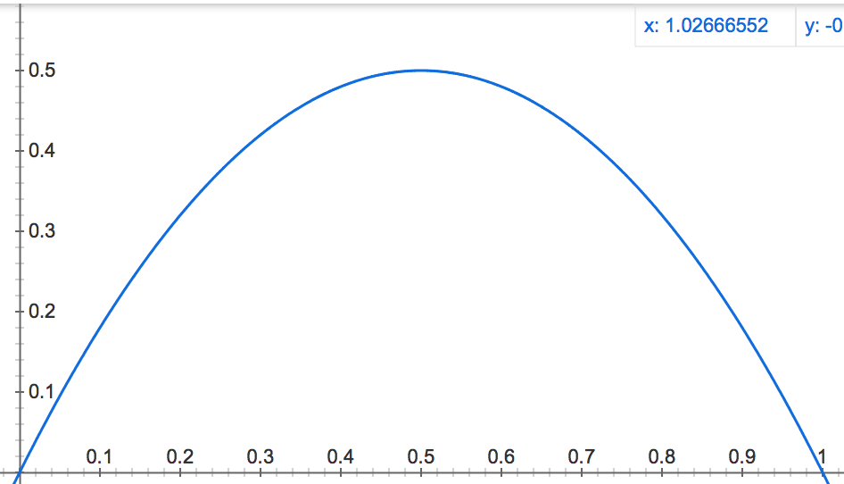
P(X=k|θ) = _{n}C_{k} θ^{k}(1-θ)^{n-k}
n = 2
L (θ | X = 1) = P (X = 1|θ) = 2θ x (1-θ)
Area = 1/3
Likelihood
θ
Maximum Likelihood (最尤推定値)

Slide 22
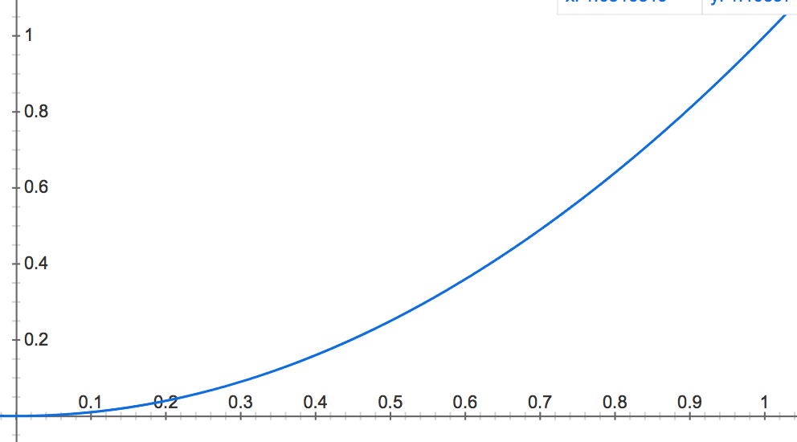
P(X=k|θ) = _{n}C_{k} θ^{k}(1-θ)^{n-k}
n = 2
L (θ | X = 2) = P (X = 2|θ) = θ ²
Likelihood
θ

Slide 23
Baysean Inference
https://www.youtube.com/watch?v=-e8wOcaascM
P(θ|data) = [P(data|θ) x P(θ)] / P(data)
Thomas Bayes 1701-1761
Posterior = Likelihood x Prior / P(data)

Slide 24
Likelihood (尤度)
X = 0 No Disease
X = 1 Disease
Goal: estimate the probability θ that a randomly chosen person has a disease
P(X=0|θ) = 1 – θ
P(X=1|θ) = θ
1.0
Likelihood
0.5
0
0 0.2 0.4 0.5 0.6 0.8 1.0
θ

Slide 25
Example of Bayes Inference (from Dobson and Barnett, 2008)
Infection by Schistosoma japonicum
θ : Infection rate
H0: Infection is not endemic ( θ <= 0.5)
H1: Infection is endemic (θ > 0.5)
After a visit to a village, the investigator thinks he is 80% sure that infection is endemic.
Sampling stool from 10 individuals of the village 7 had S. japonicum
P (y|θ) = Bin(10, θ) = ₁₀C₇ x θ⁷ x (1-θ)³

Slide 26
θ | Hypothesis | P(θ) Prior | P(y|θ) Likelihood | P(y|θ)x P(θ) | P(θ|y) Posterior
0.0 | H₀ | 0.0333 | 0.000 | 0.000 | 0.000
0.1 | H₀ | 0.0333 | 0.000 | 0.000 | 0.000
0.2 | H₀ | 0.0333 | 0.001 | 0.000 | 0.000
0.3 | H₀ | 0.0333 | 0.009 | 0.000 | 0.002
0.4 | H₀ | 0.0333 | 0.043 | 0.001 | 0.011
0.5 | H₀ | 0.0333 | 0.117 | 0.004 | 0.032
Sum |  | 0.2 |  |  | 0.046
0.6 | H₁ | 0.16 | 0.215 | 0.034 | 0.277
0.7 | H₁ | 0.16 | 0.267 | 0.043 | 0.344
0.8 | H₁ | 0.16 | 0.201 | 0.032 | 0.260
0.9 | H₁ | 0.16 | 0.057 | 0.009 | 0.074
1.0 | H₁ | 0.16 | 0.000 | 0.000 | 0.000
Sum |  | 0.8 |  | 0.124 | 0.954

Slide 27
ベイズ推定 （Bayes inference)
P(θ|data) = [P(data|θ) x P(θ)] / P(data)
： 確率分布のパラメータ
(例： Poisson分布の λ)

Slide 28
ベイズの定理の応用例

